Slide 1

Artificial Neural Networks
CISC 340 Introduction to Artificial Intelligence
Chad Van Chu & Brian Grey

Slide 2
What are we doing today?
Artificial Neural Networks
Why?
Brain stuff
Theory
Basics
Modern application

Slide 3
Artificial Neural Networks
What are they?
Break down the words
Artificial
Not naturally occurring
Neural
Relating to the nervous system
Networks
Interconnected structures
What is the analog of a ANN?
The brain

Slide 4
Why model the brain?
Sounds dumb let’s be serious
What is the brain responsible for?
Thought
Logic
Reason
Understanding
Imagination
Creativity
Free-will*
And so on…
Learning
Motion
All Senses
Perception
Emotion
Memory
Language

Slide 5
The Brain
Some raw facts:
It weighs about 3 pounds
Primarily made of fat
Powered by electricity
Consumes approximately 20% of the body’s blood and oxygen
Separated from the rest of the body by the meninges
Divided up into many regions, each specializing differently
Constantly changing!
Goes through “critical periods” where certain tasks are easier to learn

Slide 6
The Brain
Some fake facts:
We use 10% of our brain
Total BS
Published in a 1907 article in Science (percent was unspecified)
Dale Carnegie referenced this fact in How to Win Friends and Influence People in 1936
Scientists do think 10% of the cells in the brain are neurons
If only used 10% of the brain and our brain makes us distinctly human, then why would it evolve in that way?
You want to volunteer to have 90% of your brain removed?

Slide 7
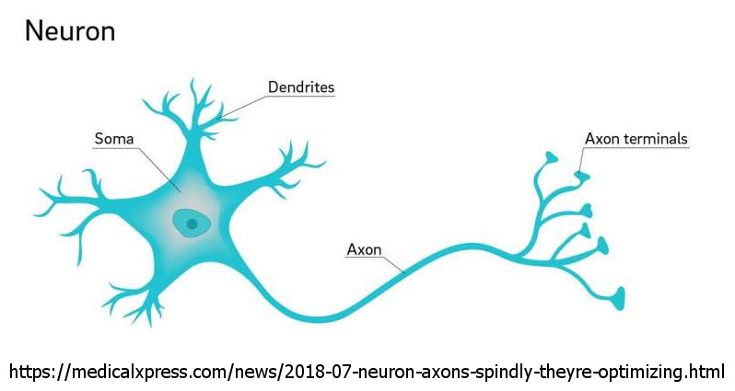
Raw Brain Power
Brain is constructed of many nerve cells call neurons

Slide 8

Raw Brain Power
Brain is constructed of many nerve cells call neurons
Very slow!
Neurons fire, at best, 1,000 times per second
As compared to this garbage fire:

Slide 9
Raw Brain Power
Brain is constructed of many nerve cells call neurons
Very slow!
Neurons fire, at best, 1,000 times per second
As compared to this garbage fire:
The VIC-20 advertised a WDC 6502 chipset
WDC 6502 chips maxed out at 1 MHz or 1,000,000 instructions per second
For $300
In 1980
The year I was born

Slide 10
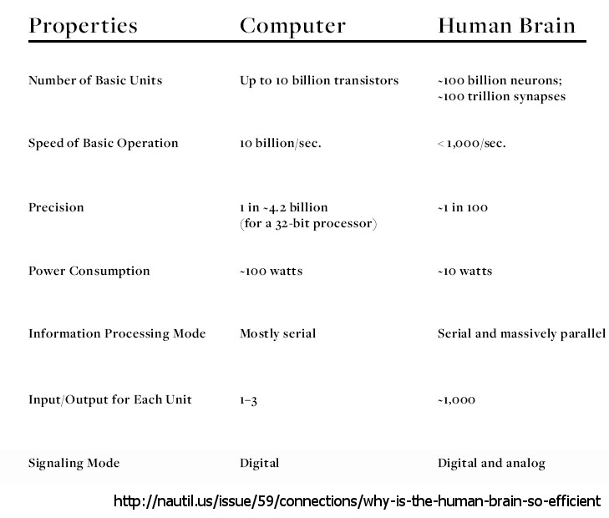
Raw Brain Power
If neurons are so crappy, why is our brain so fast?

Slide 11
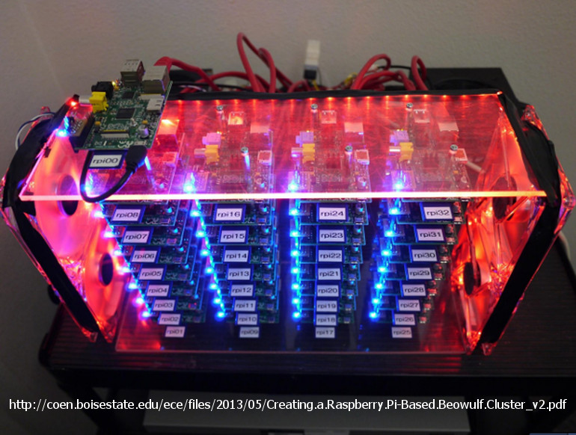
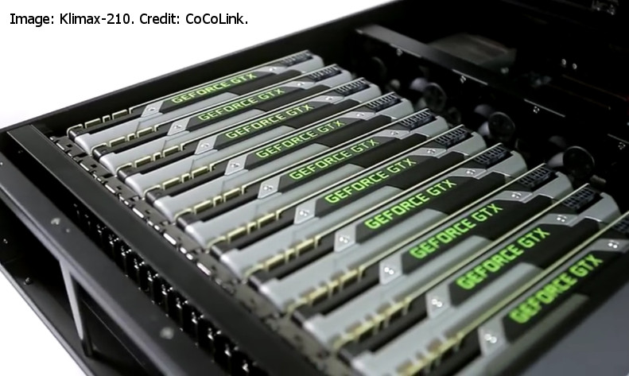
Raw Brain Power
If neurons are so crappy, why is our brain so fast?
Massively interconnected
MASSIVELY parallel on a hardware level
What does that sound like?

Slide 12
Raw Brain Power
If neurons are so crappy, why is our brain so fast?
Massively interconnected
MASSIVELY parallel on a hardware level
What does that sound like?
Artificial neural networks are the software equivalents of these parallel hardware architectures
And are frequently implemented on these hardware architectures to leverage the speed and synergies of the hardware

Slide 13
Our base unit
Base unit for calculations on a computer
The bit
Base unit for calculating things on a computer
A CPU
Or a core
I guess it’s technically the ALU…whatever
Base unit for calculating things in the brain
The neuron
Base unit for calculating things in an ANN
The perceptron

Slide 14
The Neuron
Basic unit of processing power in the brain

Slide 15
The Neuron
Basic unit of processing power in the brain
Neurons connect via dendrites and axons
Each dendrite receives information from one other neuron
Each neuron has MANY dendrites
Each neuron has one axon and transmits information to many other neurons
Therefore, each neuron can only transmit one message per firing

Slide 16
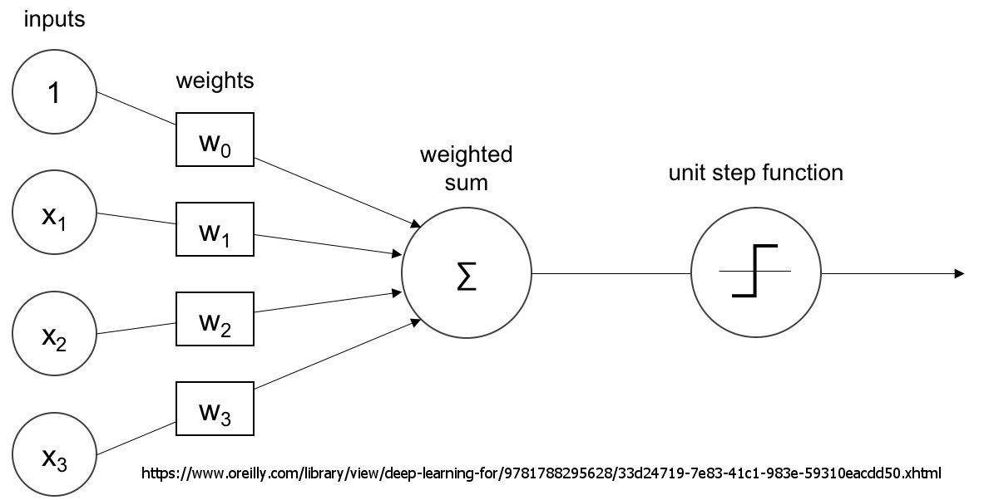
The Perceptron
Digital analog to the brain’s neuron
Perceptrons connect via standard I/O and message passing
Each input channel is from one other neuron
Each perceptron has MANY input channels
Each perceptron has one output channel and transmits information to many other perceptrons
Therefore, each perceptron can only transmit one message per firing

Slide 17

Perceptron: Under the Hood
Given $n$ inputs to any given perceptron, the output is:
$o\left(x_{1},x_{2},⋯,x_{n}\right)= \left\{\begin{aligned}1 if w_{0}+x_{1}w_{1}+x_{2}w_{2}+⋯+x_{n}w_{n}>0 \\ −1 otherwise \end{aligned}\right.$
$w_{0}$ has no associated input
Functionally, the inverse of $w_{0}$is threshold that the sum of the other weighted inputs need to exceed for the perceptron to fire
Goal:
time
But what if they’re notInputs to be classified properly every

Slide 18

Perceptron Training
First, begin with random weight vectors
Then begin training on data
For each piece of data, there are two options:
Inputs are passed through and output is correct
Do nothing.
Inputs are passed through and the output is incorrect
Weights are then modified:
$w_{i}=w_{i}+η(t−o)x_{i}$
Where $t$ is the correct output, $o$ is the incorrect output, and $η$ is the learning rate

Slide 19
What’s Actually Happening?
Perceptrons can be used to converge in a finite number of iterations on linearly separable space
What’s the problem?
MANY data sets are not linearly separable
How do we fix this?
We don’t use perceptrons
“Didn’t you say that perceptrons are the basis of all neural networks.”
Yeah…I sort of lied.

Slide 20
Let’s Look at the Perceptron Diagram Again
What can we change about the implementation from the diagram?

Slide 21
Let’s Look at the Perceptron Diagram Again
What can we change about the implementation from the diagram?
Can we change the step function?
Can we change how error is calculated for a unit?
Changing either approach can fundamentally change how the system would work

Slide 22

Linear Unit
What if there’s no “step,” just an output?
Equation:
$o\left(x_{1},x_{2},⋯,x_{n}\right)=x_{1}w_{1}+x_{2}w_{2}+⋯+x_{n}w_{n}$
$o\left(x_{1},x_{2},⋯,x_{n}\right)=\vec{x}⋅\vec{w}$
Yields a perceptron that doesn’t have a -1 to 1 threshold
Training error:
$E\left(\vec{w}\right)=\frac{1}{2}\sum_{d∈D}{{(t_{d}−o_{d})}^{2}}$
Where $D$is the set of training examples
$\vec{w}$ which minimizes $E\left(\vec{w}\right)$ is likely the best answer

Slide 23

Sigmoid Unit
What if we wanted a smooth curve?
Equation:
$o\left(x_{1},x_{2},⋯,x_{n}\right)=σ(\vec{x}⋅\vec{w}$)
$σ(y\text{)}\text{=}\frac{1}{1+e^{−y}}$
Called a squashing function as it creates an output between 0 and 1
$tanh$can also be used as the squashing function
Easily derivable
$\frac{dσ(y\text{)}}{dy}\text{=}σ(y\text{)}⋅1−σ(y\text{)}$

Slide 24
Finally, Neural Networks
Remember, we have been talking about individual units
Neural networks are groups of units arranged in layers that do not communicate with one another but do with the layer below
Units must be adjusted individually but trained in unison
Thus, the network portion of a neural network
Training is done all at once and outputs from one unit become inputs for later units
This means understanding what’s going on inside the network can be difficult
Adjusting can be complicated

Slide 25
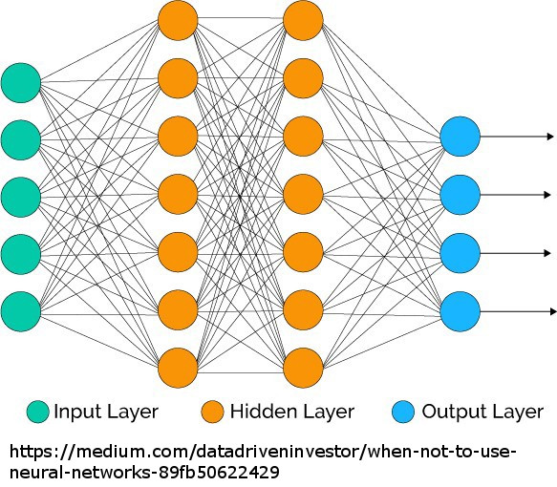
Finally, Neural Networks
Topology:
Digital neurons are arranged into layers
Typically, digital neurons from one layer feed into all digital neurons on the next layer
Inputs are frequently modeled as “nodes” in their own layer
Final layer tends to have 1 node per output value

Slide 26
Finally, Neural Networks
Topology:
Digital neurons are arranged into layers
Typically, digital neurons from one layer feed into all digital neurons on the next layer
Inputs are frequently modeled as “nodes” in their own layer
Output layer tends to have 1 node per output value
So what would our output layer look like for our golf data?
Is there any way we could configure this?
What if we wanted to predict the Outlook instead of Play Golf?

Slide 27

A few algorithms, summarized
Gradient Descent
Greedy hill climbing approach that tries to minimize error calculations by systematically changing $\vec{w}$
Backpropogation
Outputs are fed forward through the network, then error rates are started at the output units and fed backwards through the system
Recurrent Networks
Alteration of the standard feedforward configuration
Node in layer 2 communicates backwards as input to layer 1

Slide 28
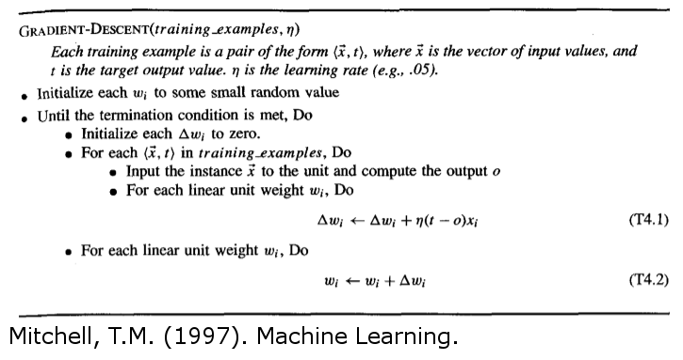
Gradient Descent
Gradient Descent
Sample Python implementation can be found here

Slide 29
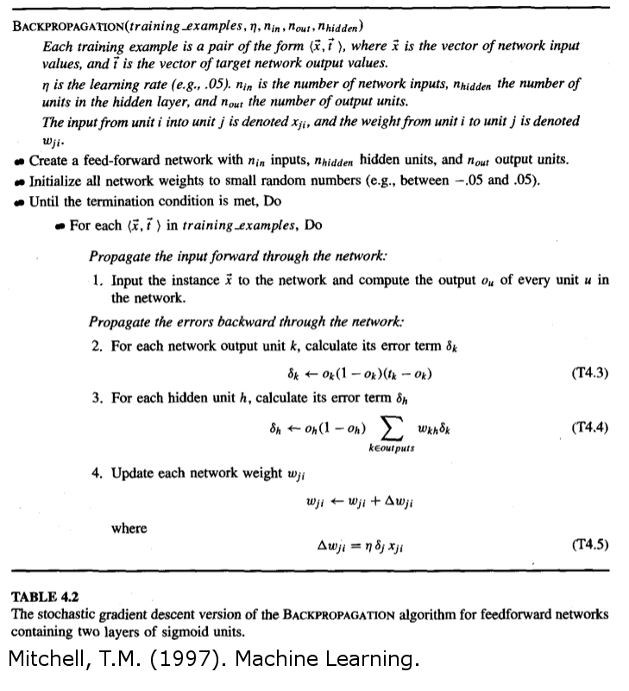
Backpropagation

Slide 30
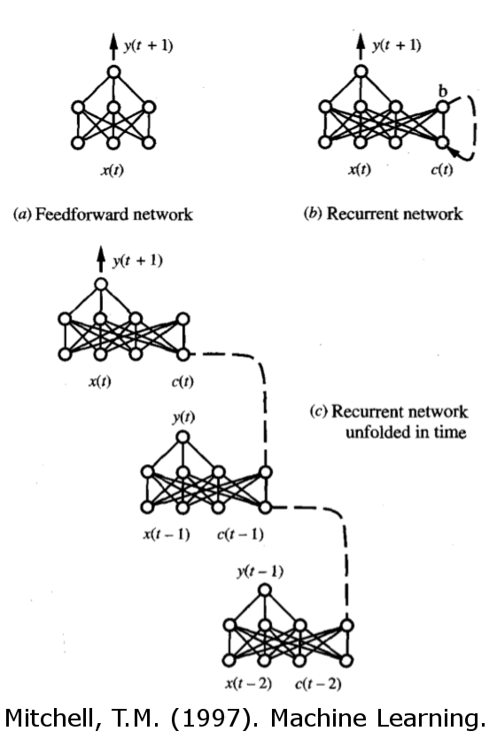
Recurrent Networks

Slide 31
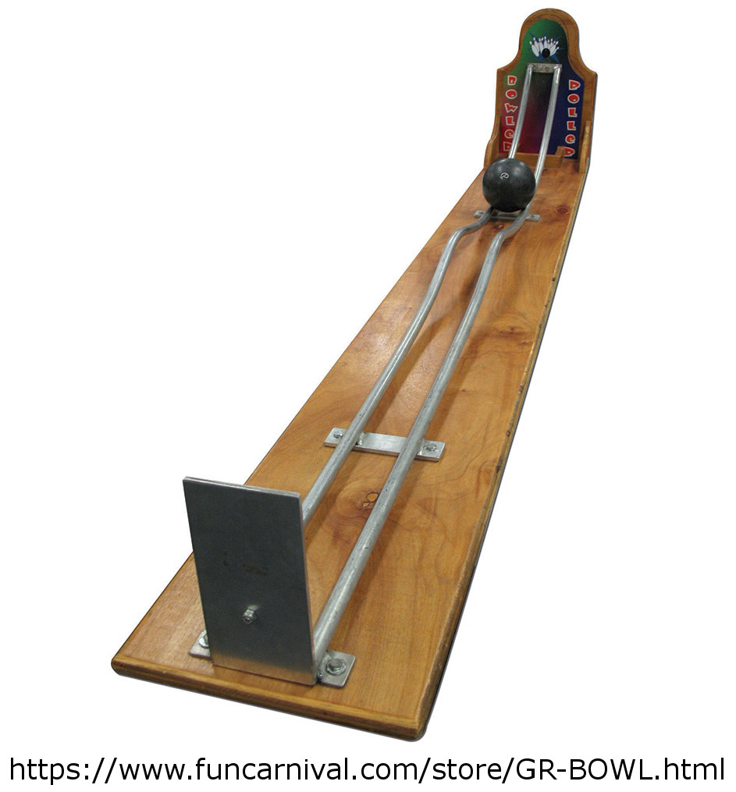
Hill Climb (Redux)
What is the weakness of hill climb algorithms?
Getting stuck in local mins/maxes
How do we avoid this?
Random starts
Probabilistic climbs
Anything else?

Slide 32

Momentum
Alteration to any hill climb to prevent getting stuck in localized minima/maxima
Continue your motion in your previous direction (at least a little)
$$∆w_{ji}\left(n\right)=ηδ_{j}x_{ji}+α∆w_{ji}\left(n−1\right)$$
$∆w_{ji}\left(n\right)$ = weight update during the nth iteration
$η$ = learning rate
$δ_{j}$ = error rate
$x_{ji}$ = input
$α$ = momentum factor, 0 ≤ $α$ < 1

Slide 33

Issues with Neural Networks
Isn’t this supervised?
How do we get data?
We need a lot of classified images
We could have people do it

Slide 34
Issues with Neural Networks
Isn’t this supervised?
How do we get data?
We need a lot of classified images
We could have people do it
Slow and lots of effort
We could have computers do it
Adversarial Neural Networks
Two neural networks working against each other for common goals
Fun video about this topic (and others)

Slide 35
Questions?

